Slide 1
NoSQL
INF08104: Database Systems
Brian Davison, 2014/15

Slide 2
Agenda
Motivation
BASE principles
Comparison with SQL
Example: MongoDB

Slide 3
Motivation
Data size
Unstructured data
Interconnection
http://www.hp.com/hpinfo/newsroom/press_kits/2012/HPDiscoverFrankfurt2012/IO_Whitepaper_Harness_the_Power_of_Big_Data.pdf

Slide 4
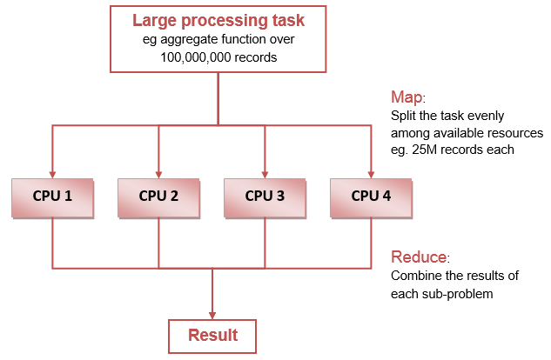
Horizontal scalability

Slide 5
Not Only SQL
Key-Value stores
Reduce relational structures to a minimum
eg Redis
Column stores
Rearrange data to store column values together
eg Cassandra
Document stores
Data stored as nested objects
eg MongoDB
Graph stores
Data stored as connected nodes – good for semantic Web
eg DB2

Slide 6
BASE
Basically available
Performance is the priority
Soft State
Temporary inconsistency is tolerated
Eventually consistent
Data converges to a consistent state
Brewer’s CAP theorem: only two are possible
Consistency
Availability
Partition tolerance

Slide 7
NoSQL terminology
SQL terminology | MongoDB terminology
database | database
table | collection
row | document
column | field
index | index
table joins | embedded documents and linking
primary key | primary key

Slide 8
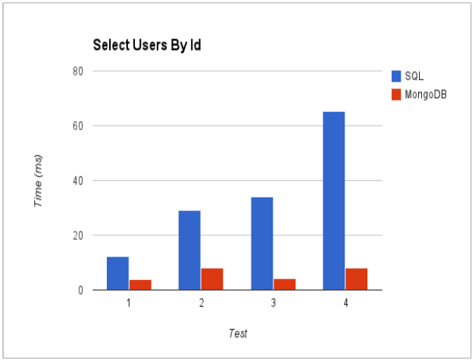
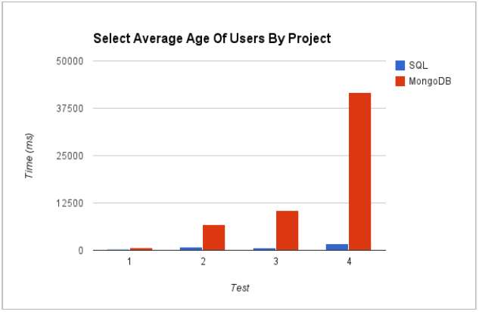
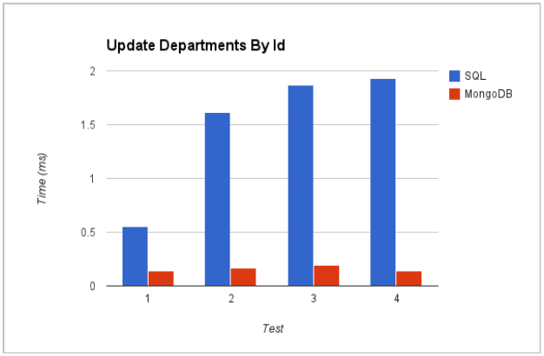
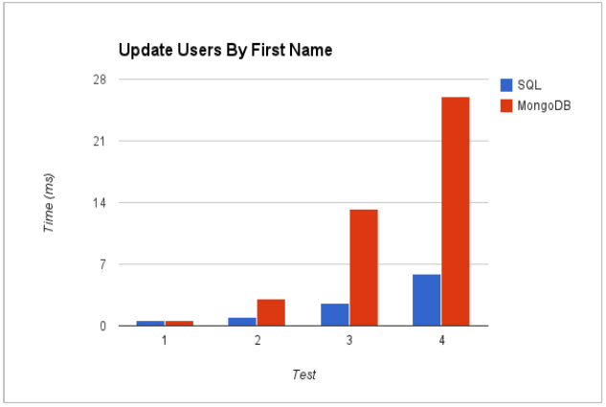
Performance

Slide 9
MongoDB
{ _id : 1,
matric : 40000001,
name : { first : "John", last : "Johnson" },
programme : {qualification : "BEng", title : "Computing" },
modules : [ {code: "SET07102",
title: "Software Development 1", Result : 75 },
{code: "CSN07101",
title: "Computer Systems 1", Result : 66 },
{code: "SET08108",
title: "Software Development 2", Result: "NULL"},
{code: "INF08104",
title: "Database Systems", Result: "NULL"}
]
}

Slide 10
MongoDB operations
db.students.insert( {
matric: 40000001,
name: {first: "John", last: "Johnson"},
programme: {qualification: "BEng", title: "Computing"} );
db.students.find( {matric: 40000001} );
db.students.update( {matric: 40000001},
{$set: programme.qualification: "BSc"} );
db.students.remove( {matric: 40000001} );

Slide 11
MongoDB aggregation
db.students.aggregate( {
$match: { $and: [ {programme.qualification: "BEng"},
{programme.title: "Computing" } ] },
$group: { _id: "$matric",
average: { $avg: modules.result } }
} )

Slide 12
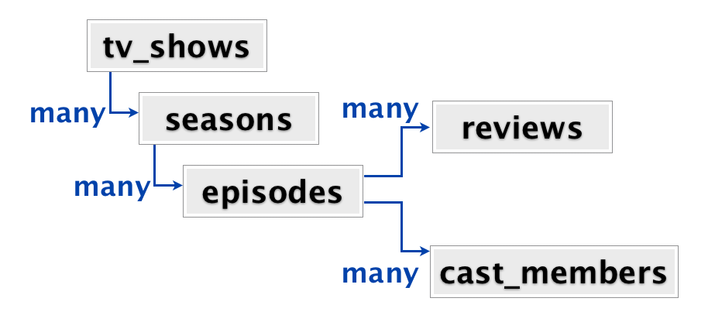
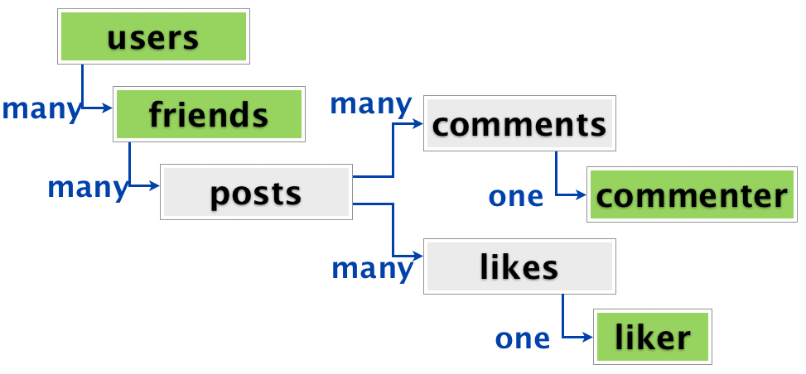
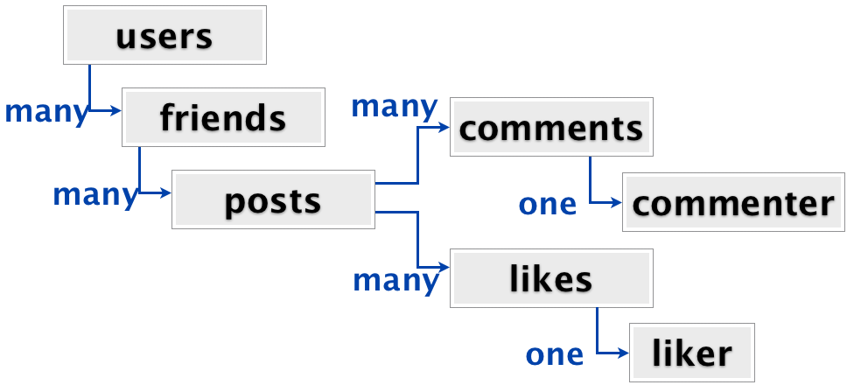
The Diaspora project
Chose MongoDB for distributed, unstructured data
Overhead of performing JOINs in code
http://www.sarahmei.com/blog/2013/11/11/why-you-should-never-use-mongodb/

